Slide 1

🪔 Diwali Sales Analysis
Submitted By: Mutha Hasith
Reg No: 12301431 | INT375 Project
Roll no: 3 | Section: K23GN
Submitted to: Mrs.Aashima
Lovely Professional University

Slide 2

Introduction
The Diwali season witnesses a massive surge in consumer purchases, both online and offline.
Understanding customer behavior during this period is essential for planning targeted campaigns.
This project performs an Exploratory Data Analysis (EDA) on Diwali sales data to identify patterns.
The focus is on demographics like age, gender, and location to optimize sales strategies.

Slide 3
What is EDA?
Exploratory Data Analysis (EDA) helps to summarize key characteristics of data.
It reveals relationships, trends, and anomalies using visual and statistical methods.
Techniques used include histograms, box plots, scatter plots, and descriptive stats.
EDA is the foundation of any data-driven decision-making process.

Slide 4

Why EDA is Important for Diwali Sales
Helps identify which customer segments are the most profitable.
Improves inventory allocation and reduces unsold stock.
Enables more accurate demand forecasting during the festive period.
Assists in planning effective marketing strategies based on real data.

Slide 5
Source of Dataset
Dataset sourced from a CSV file: 'Diwali Sales Data.csv'.
Fields include Gender, Age, State, Orders, and Amount.
Data was cleaned and processed using Python (Pandas, NumPy).
Encoding used: Latin1 to handle special characters in names and places.
Link:https://github.com/rishabhnmishra/Python_Diwali_Sales_Analysis/blob/main/Diwali%20Sales%20Data.csv

Slide 6
Step-by-Step EDA Process
1. Load dataset using Pandas and inspect structure.
2. Clean data: fix column names, convert data types, handle missing values.
3. Engineer new features: Age Group, Age-Gender Combo.
4. Perform univariate, bivariate, and multivariate analyses.
5. Detect outliers using IQR and visualize correlations.

Slide 7
Dataset Preprocessing
Column names were stripped of whitespaces and standardized.
Amount and Orders columns converted to numeric for accurate analysis.
Missing values were dropped to maintain data integrity.
Age_Group was derived from Age to create clear customer segments.

Slide 8
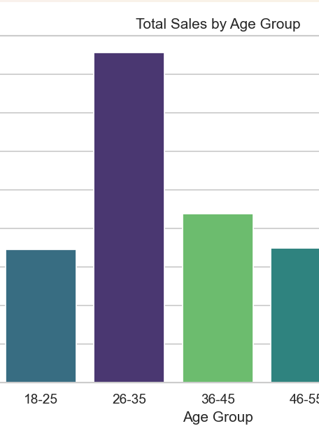
Objective 1: Sales by Age Group
Customers were grouped by age brackets like 18–25, 26–35, etc.
Total sales (Amount) were calculated for each age group.
The 26–35 age group emerged as the highest spender during Diwali.
Visualized with a bar chart for comparative analysis.

Slide 9
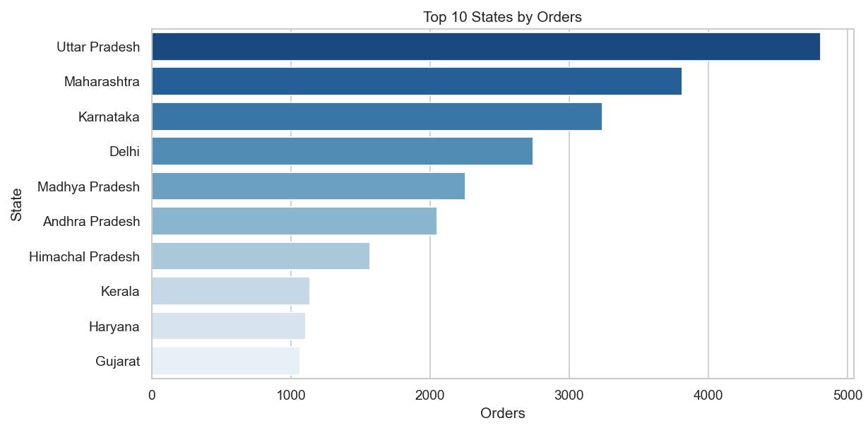
Objective 2: Top States by Orders
States were grouped and ranked based on total number of orders.
Top states include Uttar Pradesh, Maharashtra, and Karnataka.
These states have high urban populations and strong e-commerce presence.
Horizontal bar chart used for clear representation.

Slide 10
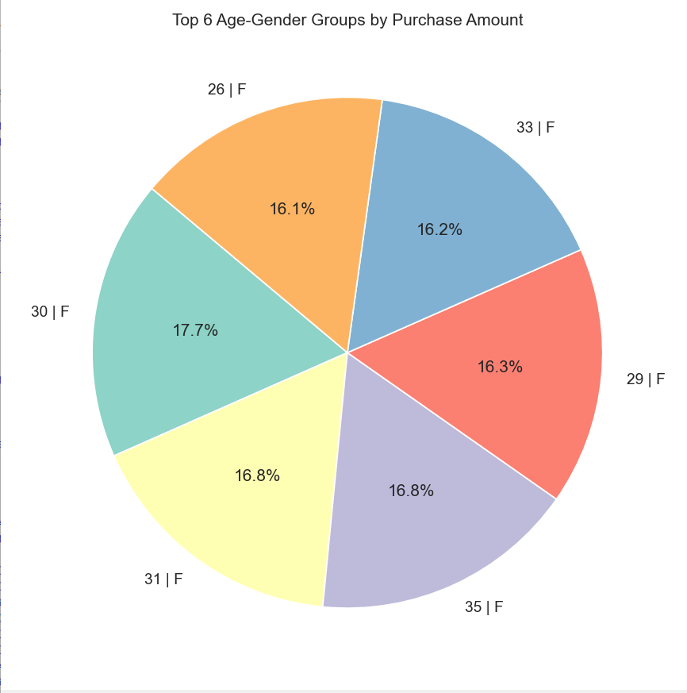
Objective 3: Purchase Pattern by Age-Gender
Created a new column combining Age Group and Gender (e.g., 18-25_Male).
Identified the most profitable demographic segments.
Both young males and females (18–35) were top spenders.
Visualized using a pie chart to show percentage contribution.

Slide 11
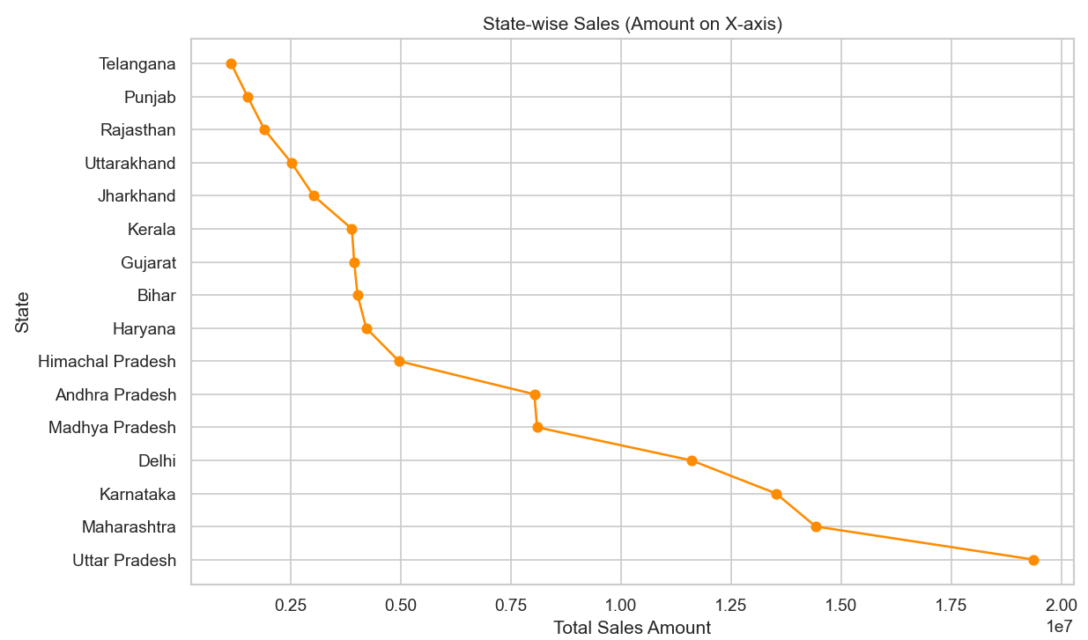
Objective 4: State-wise Sales Trends
Total Amount spent per state was calculated to understand revenue trends.
Northern and Western states showed higher revenue generation.
Line plots were used to highlight the gradual drop across lower-performing states.
Insights help optimize region-based marketing efforts.

Slide 12
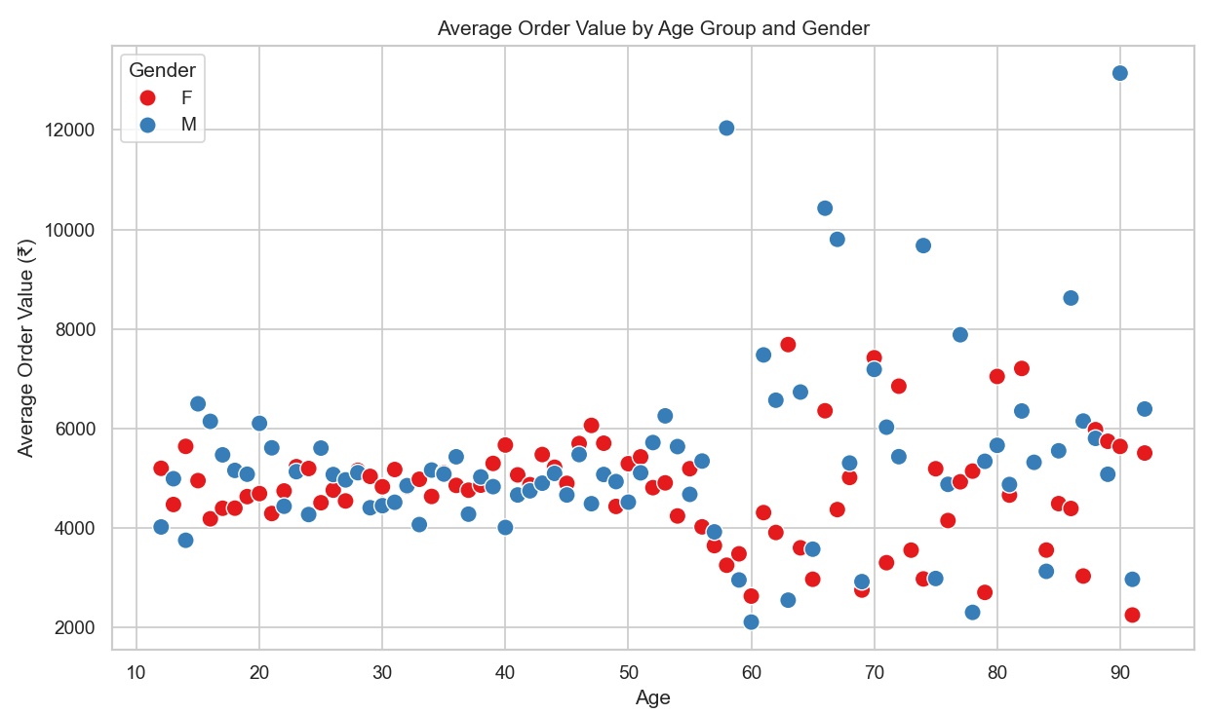
Objective 5: Avg Order Value (AOV)
AOV calculated as Amount / Orders for each age and gender group.
Older demographics placed fewer but high-value orders.
Gender difference was minimal, showing balanced spending patterns.
Visualized using scatter plots for clarity.

Slide 13
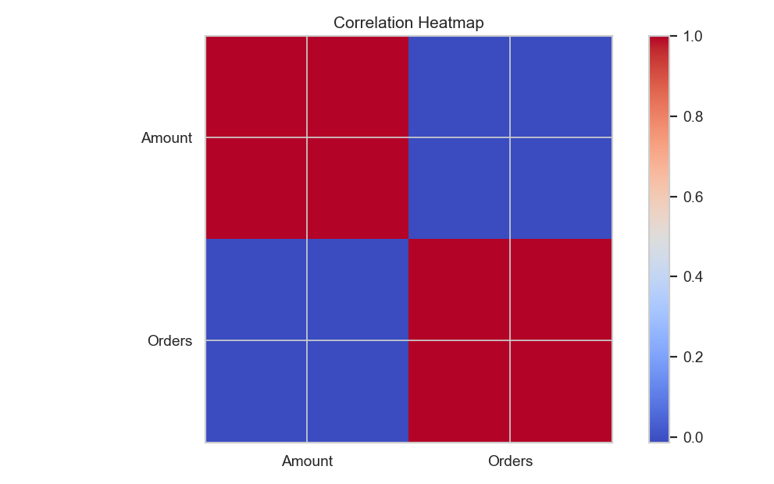
Objective 6: Relationship Between Amount and Orders
Evaluated correlation between total orders and purchase amount.
Used heatmap and pairplot to visualize linear relationships.
Found a strong positive correlation—more orders = more spending.
Supports bundling and upselling strategies.

Slide 14
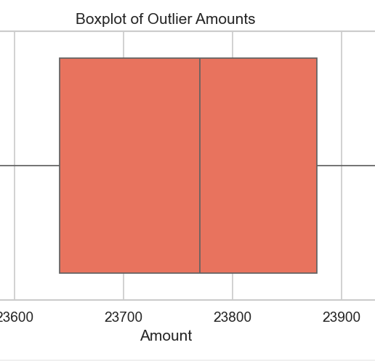
Objective 7: Outlier Detection
Outliers were detected using IQR method on the Amount column.
Boxplot revealed several large purchase values.
These may indicate bulk buyers or corporate transactions.
Important for identifying special customer segments.

Slide 15

Conclusion & Future Scope
Key Findings:
- 26–35 age group and 18–35 segment are top spenders.
- Top states drive majority of revenue.
- Orders and Amount are strongly linked.
- High-value outliers present business opportunities.
Future Scope:
- Add product-level and time-based analysis.
- Use ML models for prediction.
- Integrate customer feedback and real-time dashboards.

Slide 16


